Slide 1

Multi-Agent Systems Project Presentation
Professors: Andrea Omicini, Roberta Calegari
Student: Andrea Perna
University of Bologna

Slide 2
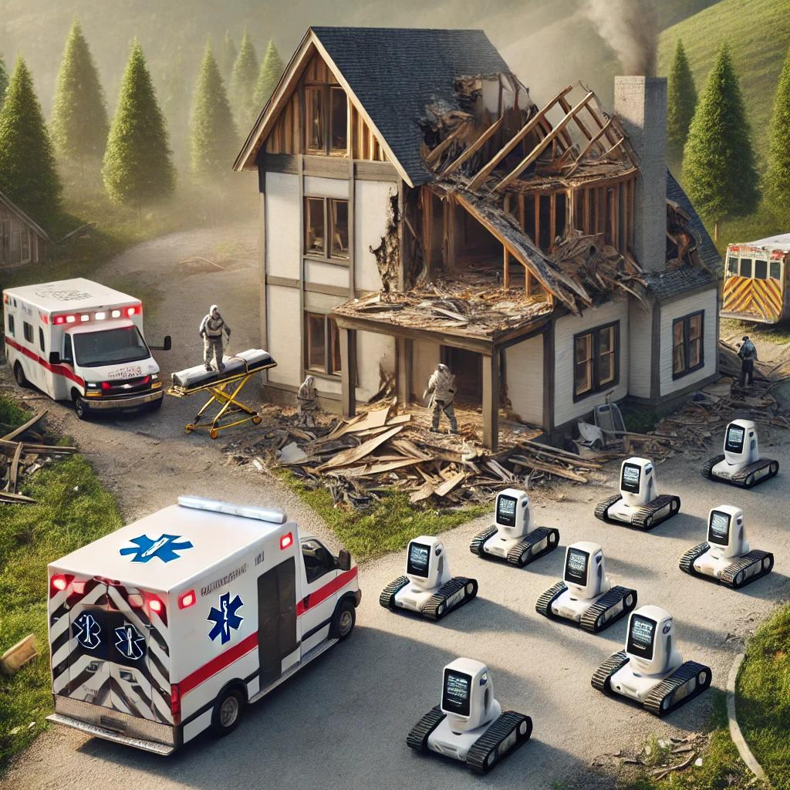
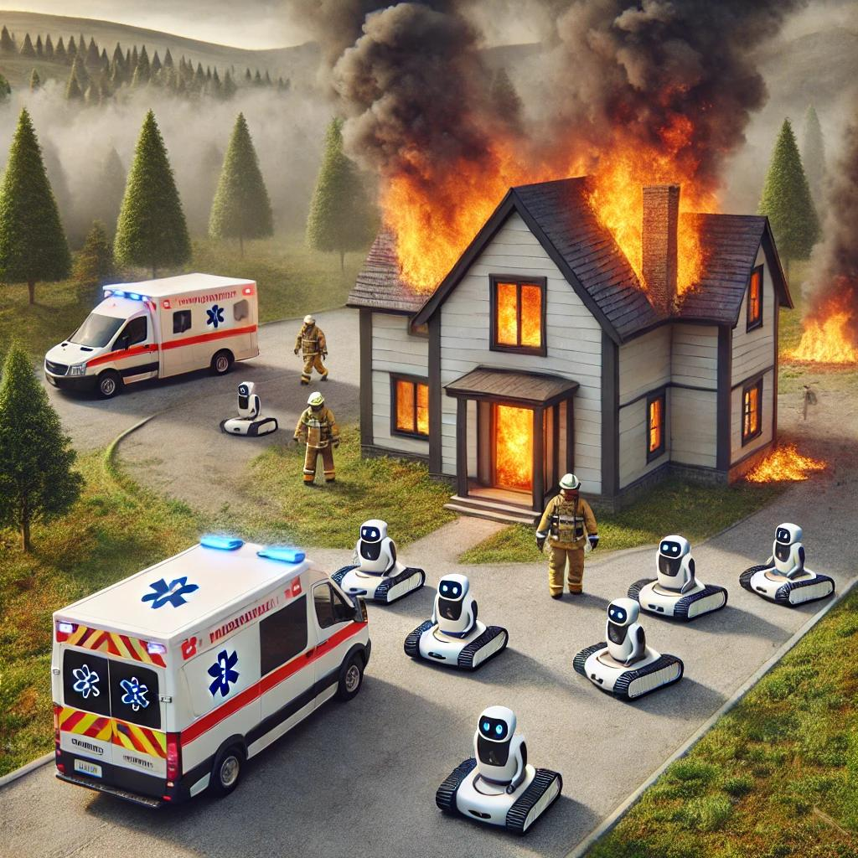
Project Motivations

Slide 3
Project Goals
Multi-Agent System
Engineer a clear separation between agents and environment;
Distributed Optimization
Implement distributed aggregative optimization algorithm to provide distributed coordination;
Beliefs-Desires-Intentions
Leverage the BDI framework to govern robots’ behaviors;
Create a distributed network of robotic agents modelled with a strongly connected graph;
Design mentalistic agents, inspired by agency’s strong definition;
Agents aim to fulfill both local and global targets, by reaching consensus on global information;
Ensure efficient navigation with obstacle avoidance;
Design a modular Multi-Agent System (MAS) for Search and Rescue missions (SAR) in Python;
Enable real-time decision-making, to cope with dynamic and unpredictable environments;

Slide 4

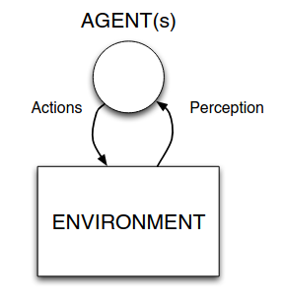
System Architecture
The system's modularity separates environment and agents in the MAS, using agent-oriented programming to give robots the autonomy to achieve their goals.
Environment Class
House: Simulated layout with defined rooms, obstacles, and openings.
Survivors: Individuals needing rescue, placed in the environment.
Ambulance: Vehicle transporting survivors to safety;
Agent Class
Agents behave using the Belief-Desire-Intention (BDI) framework.
Use distributed aggregative optimization algorithm to make optimal decisions aiming to achieve both local and global tasks;
Navigate the environment while performing obstacle avoidance;
Agent(s) Model: Russel and Norvig, 2022

Slide 5
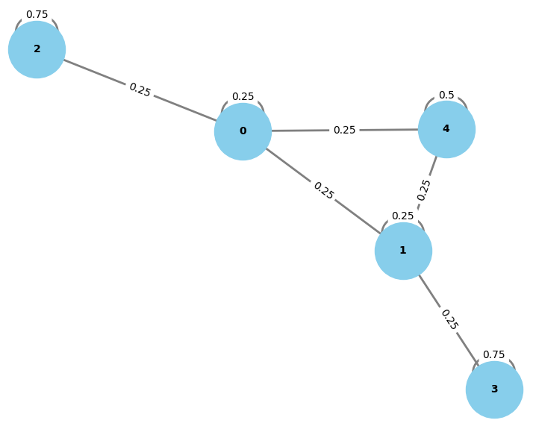
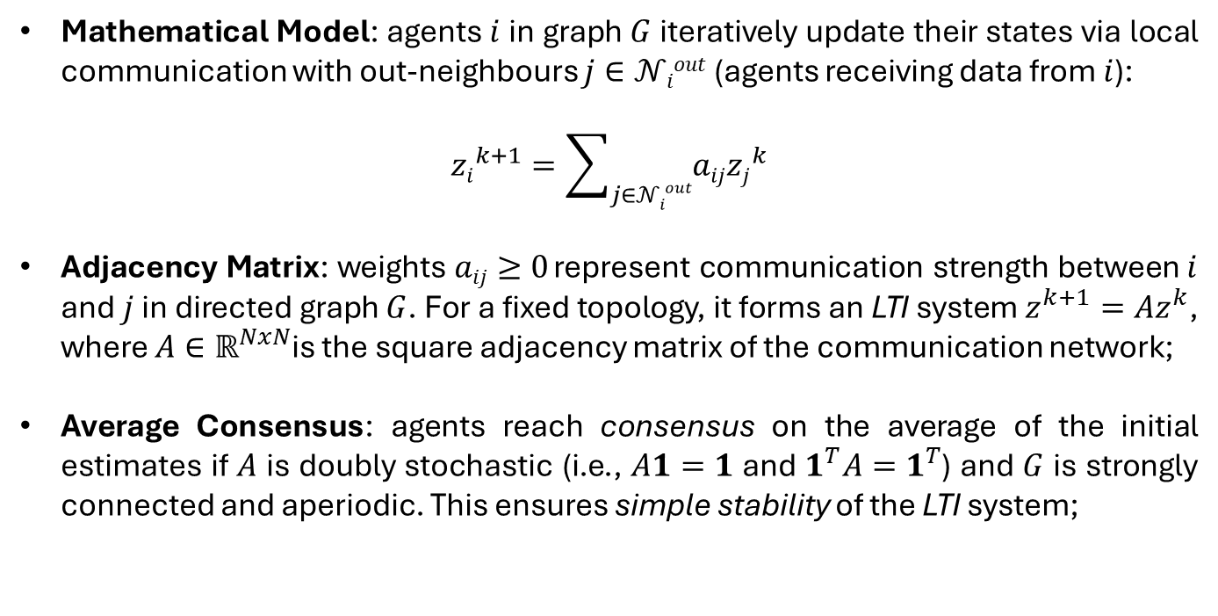
Consensus Theory
Consensus Theory provides mathematical tools to reach agreement among distributed agents on a quantity.
Mathematical Model: agents $i$ in graph $G$iteratively update their states via local communication with out-neighbours $j∈𝒩iout$ (agents receiving data from $i$):
$${zi}^{k+1}=\sum_{j∈𝒩iout}{aij{zj}^{k}}$$
Adjacency Matrix: weights $aij≥0$ represent communication strength between $i$ and $j$ in directed graph $G$. For a fixed topology, it forms an LTI system $z^{k+1}=Az^{k}$, where $A∈ℝ^{NxN}$is the square adjacency matrix of the communication network;
Average Consensus: agents reach consensus on the average of the initial estimates if $A$ is doubly stochastic (i.e., $A1=1$ and $1^{T}A=1^{T}$) and $G$ is strongly connected and aperiodic. This ensures simple stability of the LTI system;
Graph Connectivity, 5 Agents Network

Slide 6
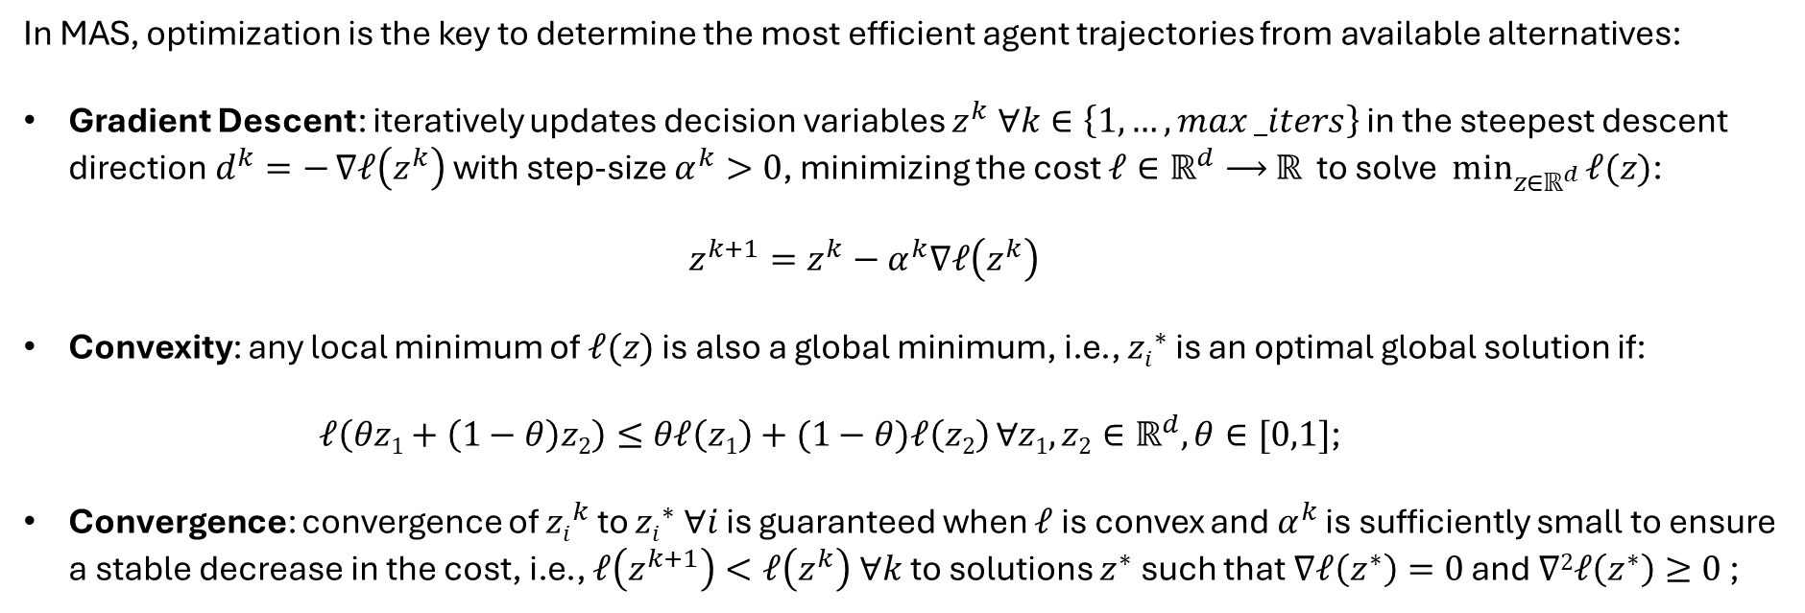
Optimization Theory
In MAS, optimization is the key to determine the most efficient agent trajectories from available alternatives:
Gradient Descent: iteratively updates decision variables $z^{k} ∀k∈\left\{1, …, max⁡_iters\right\}$ in the steepest descent direction$d^{k}=−$ $∇ℓ\left(z^{k}\right)$ with step-size $α^{k}>0$, minimizing the cost $ℓ∈ℝ^{d}⟶$ $ℝ$ to solve $\min_{z∈ℝ^{d}}{ℓ(z)}$:
$$z^{k+1}=z^{k}−α^{k}∇ℓ\left(z^{k}\right)$$
Convexity: any local minimum of $ℓ(z)$ is also a global minimum, i.e., ${zi}^{∗}$ is an optimal global solution if:
$ℓ\left(θz1+\left(1−θ\right)z2\right)≤θℓ\left(z1\right)+(1−θ)ℓ\left(z2\right) ∀z1,z2∈ℝ^{d},θ∈[0,1]$;
Convergence: convergence of ${zi}^{k}$ to ${zi}^{∗} ∀i$ is guaranteed when $ℓ$ is convex and $α^{k}$ is sufficiently small to ensure a stable decrease in the cost, i.e., $ℓ\left(z^{k+1}\right)<ℓ\left(z^{k}\right) ∀k$ to solutions $z^{∗}$ such that $∇ℓ\left(z^{∗}\right)=0$ and $∇2ℓ\left(z^{∗}\right)≥0$ ;

Slide 7
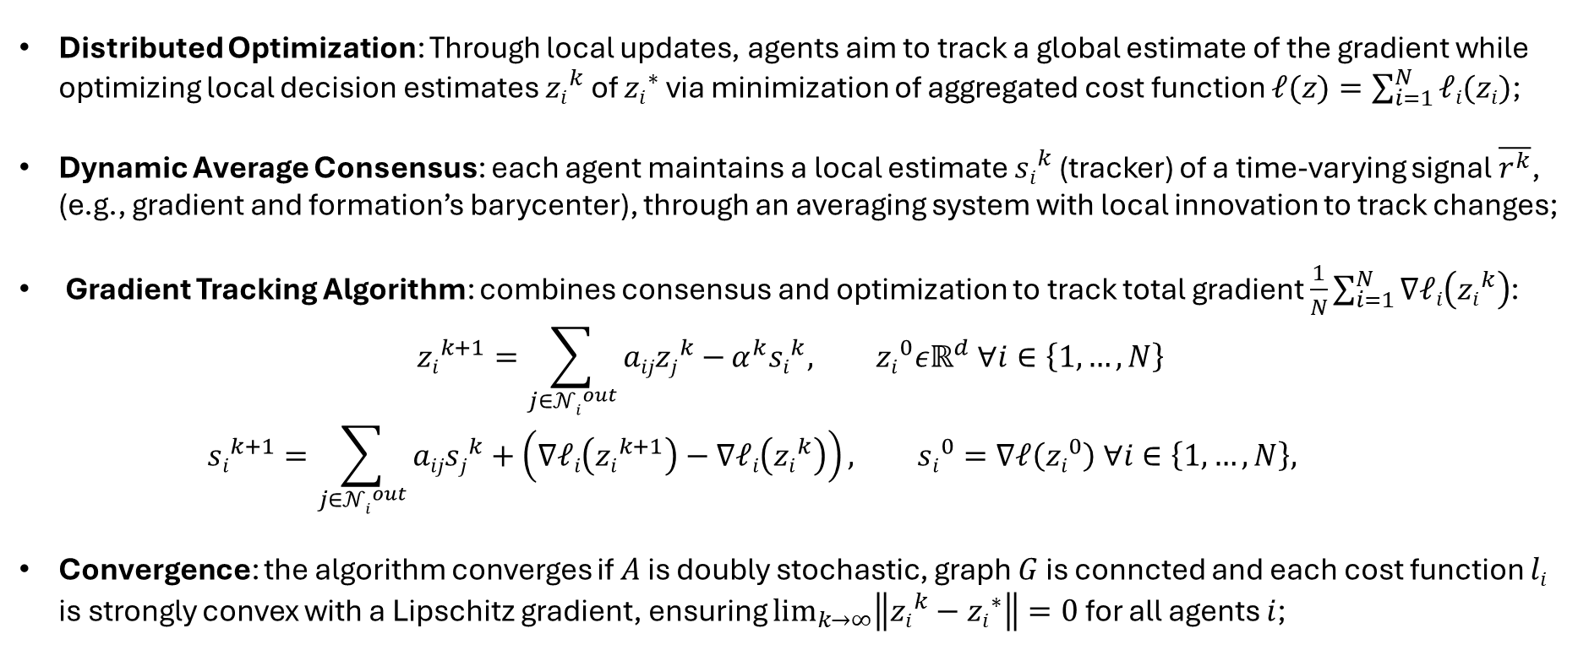
Gradient Tracking Algorithm
Distributed Optimization: Through local updates, agents aim to track a global estimate of the gradient while optimizing local decision estimates ${zi}^{k}$ of ${zi}^{∗}$ via minimization of aggregated cost function $ℓ(z)=\sum_{i=1}^{N}{ℓi(zi)}$;
Dynamic Average Consensus: each agent maintains a local estimate ${si}^{k}$ (tracker) of a time-varying signal $\overline{r^{k}}$, (e.g., gradient and formation’s barycenter), through an averaging system with local innovation to track changes;
Gradient Tracking Algorithm: combines consensus and optimization to track total gradient $\frac{1}{N}\sum_{i=1}^{N}{∇ℓi\left({zi}^{k}\right)}$:
$${zi}^{k+1}=\sum_{j∈{𝒩i}^{out}}{aij{zj}^{k}−}α^{k}{si}^{k}, {zi}^{0}εℝ^{d} ∀i∈\left\{1,…,N\right\}$$
$${si}^{k+1}=\sum_{j∈{𝒩i}^{out}}{aij{sj}^{k}}+\left(∇ℓi\left({zi}^{k+1}\right)−∇ℓi\left({zi}^{k}\right)\right), {si}^{0}=∇ℓ\left({zi}^{0}\right) ∀i∈\left\{1,…,N\right\},$$
Convergence: the algorithm converges if $A$ is doubly stochastic, graph $G$ is conncted and each cost function $li$ is strongly convex with a Lipschitz gradient, ensuring $\lim_{k→∞}\left\|{zi}^{k}−{zi}^{∗}\right\|=0$ for all agents $i$;

Slide 8
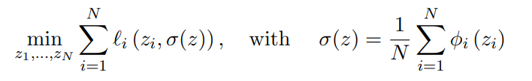
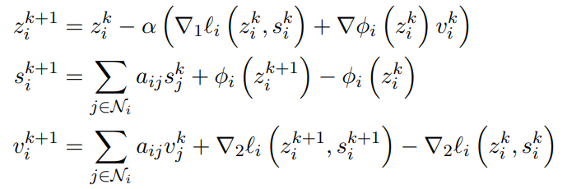
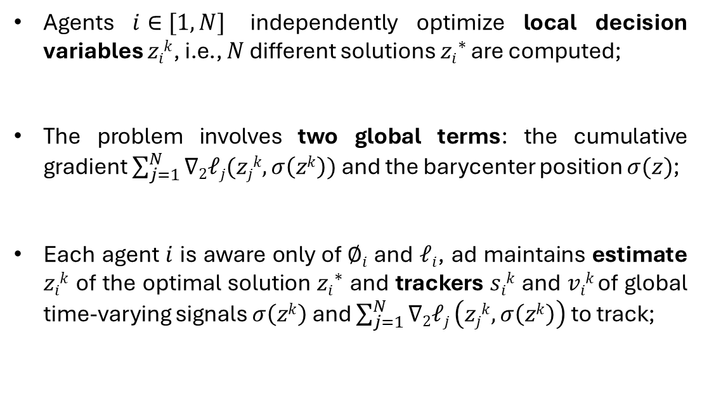
Distributed Aggregative Optimization
Aggregative Optimization involves $N$ robots optimizing positions $zi∈ℝ^{2}, i∈1, …, N$ by minimizing local cost functions $ℓi\left(zi,σ\left(z\right)\right)$, which rely on global time-varying information estimated through Gradient Tracking algorithm:
Agents $i∈[1,N]$ independently optimize local decision variables $zik$, i.e., $N$ different solutions ${zi}^{∗}$are computed;
The problem involves two global terms: the cumulative gradient $\sum_{j=1}^{N}{∇2ℓj(zjk,σ\left(zk\right))}$ and the barycenter position $σ(z)$;
Each agent $i$ is aware only of $∅i$ and $ℓi$, ad maintains estimate $zik$ of the optimal solution ${zi}^{∗}$ and trackers $sik$ and $vik$of global time-varying signals $σ\left(zk\right)$ and $\sum_{j=1}^{N}{∇2ℓj}\left(zjk,σ\left(zk\right)\right)$ to track;

Slide 9
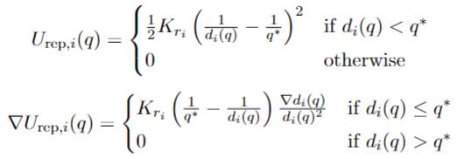
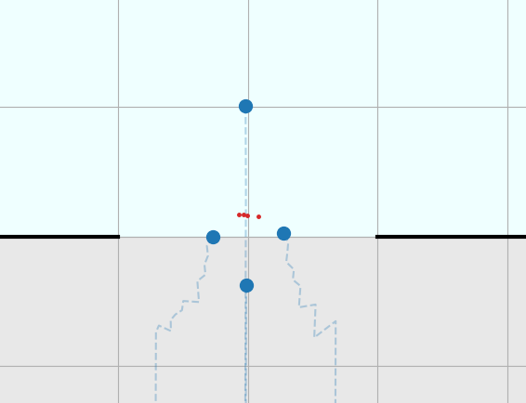
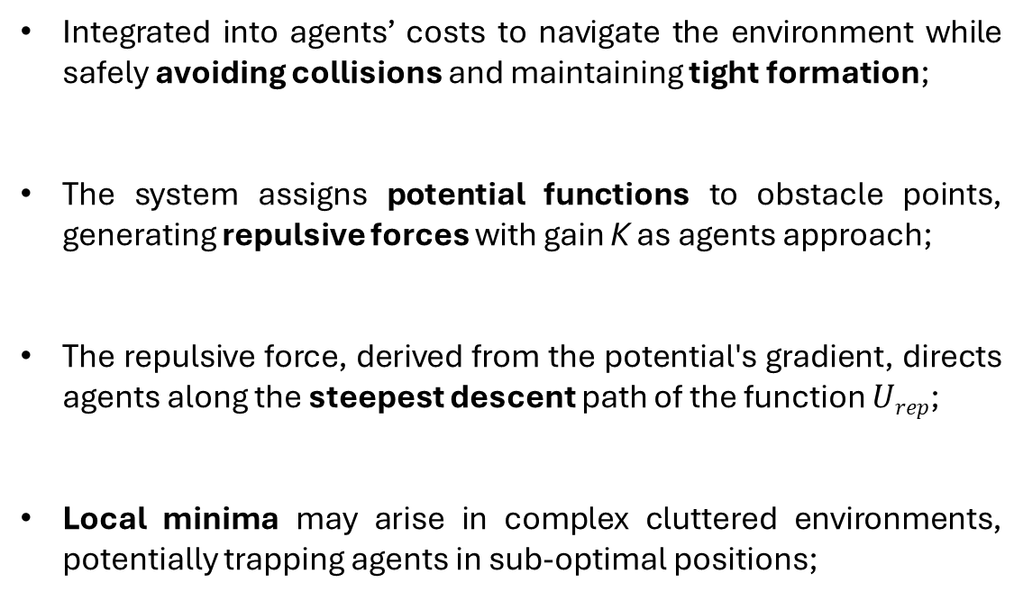
Obstacle Avoidance
Integrated into agents’ costs to navigate the environment while safely avoiding collisions and maintaining tight formation;
The system assigns potential functions to obstacle points, generating repulsive forces with gain K as agents approach;
The repulsive force, derived from the potential's gradient, directs agents along the steepest descent path of the function $Urep$;
Local minima may arise in complex cluttered environments, potentially trapping agents in sub-optimal positions;
Example of Room Walls Avoidance

Slide 10
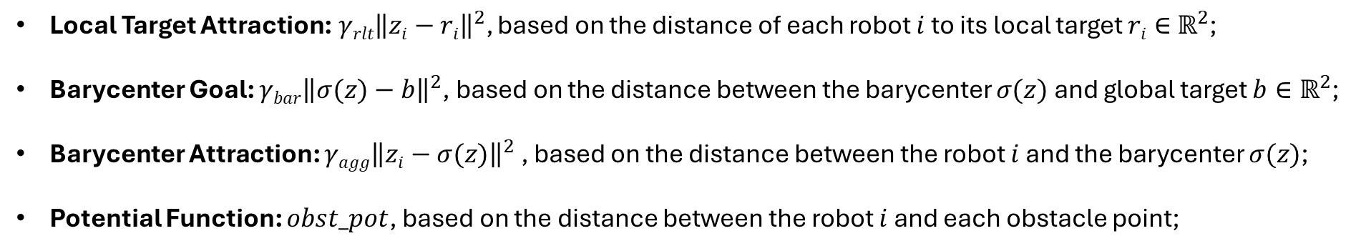
Cost Function
The algorithm’s effectiveness hinges on the cost function convex structure, dictating agents’ behaviors:
$$ℓi\left(zi, σ\left(z\right)\right)=γrlt{\left\|zi−ri\right\|}^{2}+γbar{\left\|σ(z)−b\right\|}^{2}+γagg{\left\|zi−σ(z)\right\|}^{2}+obst_pot$$
Local Target Attraction:$γrlt{\left\|zi−ri\right\|}^{2}$, based on the distance of each robot $i$ to its local target $ri∈$ $ℝ^{2}$;
Barycenter Goal: $γbar{\left\|σ(z)−b\right\|}^{2}$, based on the distance between the barycenter $σ(z)$and global target $b∈ℝ^{2}$;
Barycenter Attraction: $γagg{\left\|zi−σ(z)\right\|}^{2}$, based on the distance between the robot $i$ and the barycenter $σ(z)$;
Potential Function: $obst_pot$, based on the distance between the robot $i$ and each obstacle point;

Slide 11
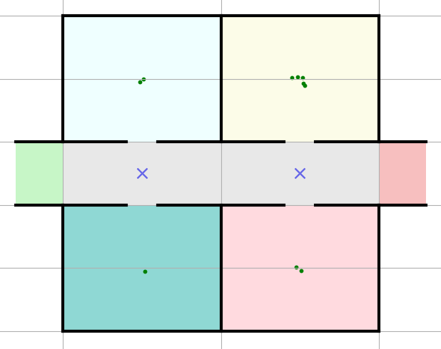
Environment
Ambulance and Survivors: FSMs used to simulate people in rooms and the ambulance escorting them;
Obstacles and Openings: walls, obstacle points and openings define the navigable space for the agents;
Midpoints: used for optimized navigation in plans, guiding agents efficiently between rooms;
Pragmatical Actions: situated agents may change the state of the environment with pragmatical actions;
Visualization: the plot_house() function provides a color-coded graphical representation of the environment;

Slide 12
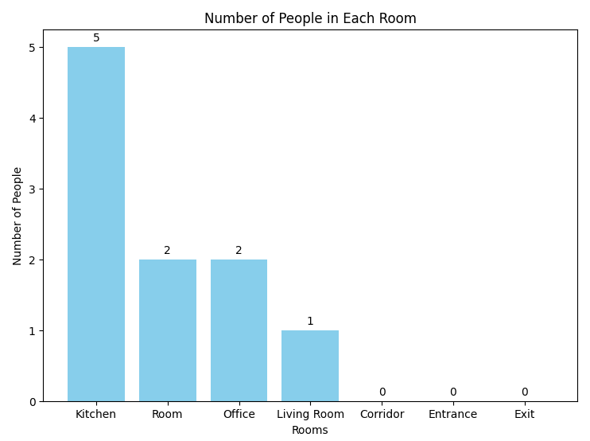
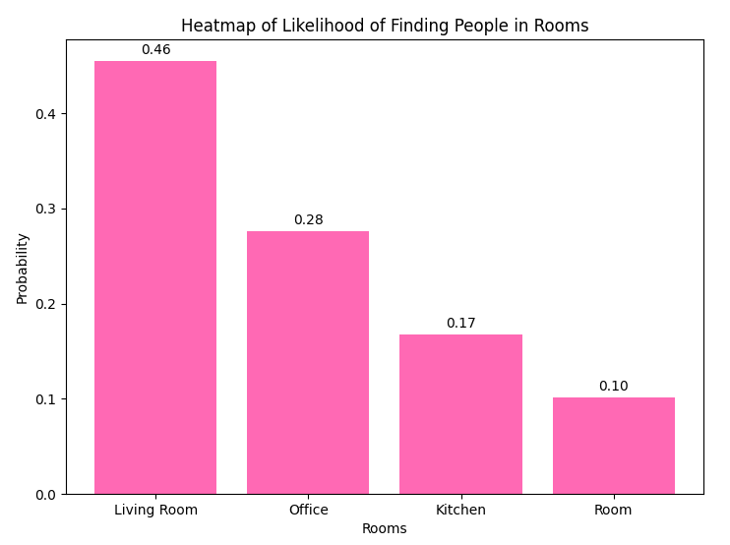
Rooms Initialization
At the beginning of the simulation, survivors are randomly placed in rooms according to a uniform distribution. The exact number of people for each room is determined by the probabilities, and it is not known by the agents.

Slide 13
Survivors
Finite State Machine
Saved survivors use P-controllers to reach the Idle ambulance in the departure point;
Groups Creation
Agents gather Steady survivors using the create_escort_group() function;
Rescue
Survivors transition to Escorted when grouped and moved to Exit with agents, where they are Saved;
Saved survivors are delivered to the hospital upon ambulance arrival, entering Transported state;
The mission continues until all survivors are Healed in hospital;
Group maximum size is limited by max_survivors_escort, capping the number of people escorted at once;
If survivors are left due to group limits, agents prioritize returning to their room over exploring new areas;
Survivor are managed by an FSM with states: Steady, Escorted, Saved, Transported and Healed;
Randomly initialized in rooms according to house’s heatmap;

Slide 14
Ambulance
Finite State Machine
Ambulance movements are synchronized with agents and survivors’ activities;
Arrival and Departure
Departing once a group of escorted survivors boards the ambulance;
Hospital
Transport survivors to the hospital, marking them Healed upon arrival;
If all survivors have been healed, then the ambulance must stay Idle, to prevent unnecessary dispatches;
After a while, another ambulance is dispatched to the exit in Returning state to collect the next group;
Operate in three states: Idle, Departing and Returning;

Slide 15
Beliefs, Desires, Intentions
Beliefs
Initialized from a YAML file;
Desires
Define the agent’s objectives based on the current context, such as escorting survivors, visiting rooms or reach exit;
Function generate_options() generates feasible desires on updated beliefs;
Intentions
Represent the plans and actions chosen to fulfill agents’ desires;
Function filter_options() selects and prioritizes one single desire;
Dynamically updated through perceive_environment() and brf();
Represent agent’s knowledge about the MAS environment;
Multiple, possibly conflicting, desires can co-exist inside agents’ minds;
Implemented by create_plan() through waypoints, obstacles and escort groups’ generation;
Include room locations, obstacle points and survivor statuses;

Slide 16
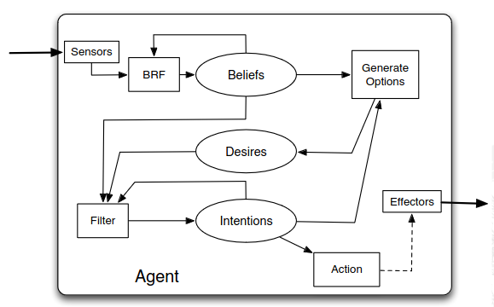
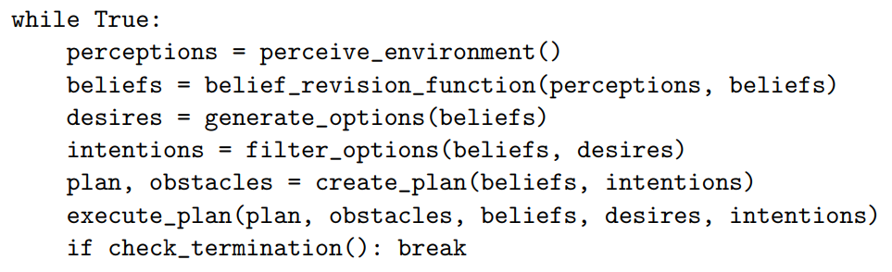
BDI Control Loop
The control loop of BDI agents represents their “minds”, continuously updating beliefs, generating desires, filtering options into intentions and executing plans to achieve their goals. Such a model follows agency’s strong definition.
Basic Architecture of a BDI Agent, Wooldridge 2009

Slide 17
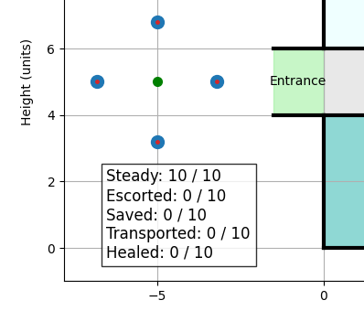
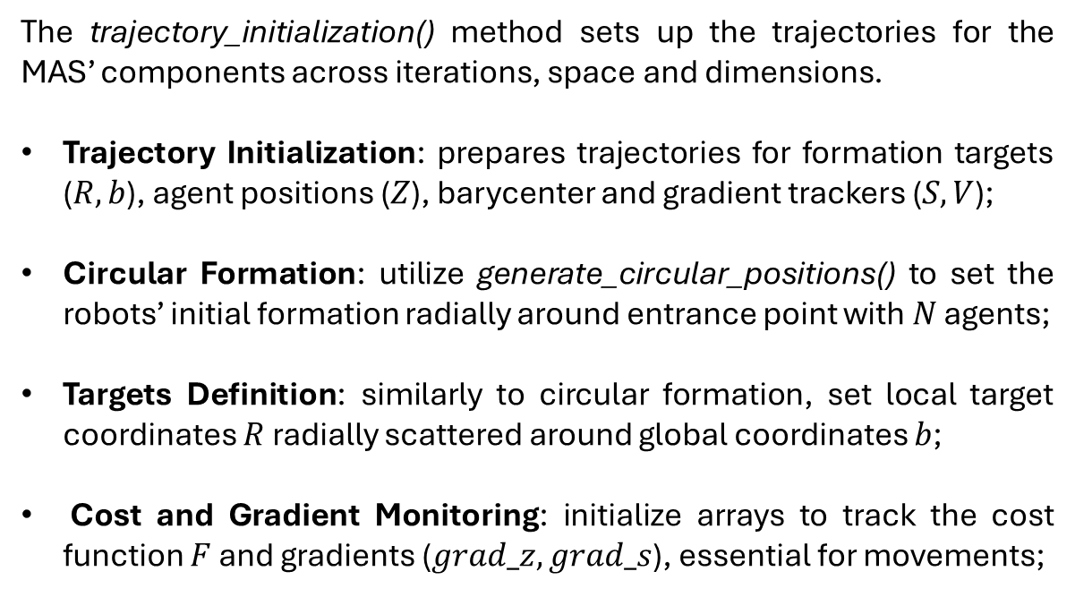
Trajectories Initialization
The trajectory_initialization() method sets up the trajectories for the MAS’ components across iterations, space and dimensions.
Trajectory Initialization: prepares trajectories for formation targets ($R, b$), agent positions ($Z$), barycenter and gradient trackers ($S,V$);
Circular Formation: utilize generate_circular_positions() to set the robots’ initial formation radially around entrance point with $N$ agents;
Targets Definition: similarly to circular formation, set local target coordinates $R$ radially scattered around global coordinates $b$;
Cost and Gradient Monitoring: initialize arrays to track the cost function $F$ and gradients ($grad_z, grad_s$), essential for movements;
Robots Trajectory Initialization, 4 Agents

Slide 18
Techniques and Procedures
Agents initially move to the local targets placed in Entrance room;
Visit rooms with highest likelihood of finding survivors, continuously updating beliefs and desires;
Escorting Survivors
Agents form a feasible escort group once they detect survivors in rooms;
Safely navigate to the exit adjusting their movements to avoid obstacles while maintaining a tight formation;
Perform communication and pragmatical actions with neighbors and the environment in the MAS;
Exiting the House
Once all known survivors have left the rooms, set intention to Exit;
A plan is created to fulfill the intention, using rooms’ waypoints, obstacles and formation’s gains;
Agents may enter Standby mode at the exit if all survivors are Saved, but not yet fully Healed;
Agents in the MAS are driven by the goal of ensuring all survivors are safely Escorted and Healed;
Entering the House

Slide 19
Visualization
The SAR_animation() function animates the trajectories of robots, survivors and the ambulance across iterations.
Plot Limits: based on view_type parameter in YAML file, they can be either static or dynamic;
House Layout: house is shown in background with walls, corridors, obstacles in a color-coded fashion;
Robots Trajectories: robots’ initial positions and trajectories are shown to illustrate movement strategies;
Survivors Trajectories: people’s positions are dynamically updated, showing progress from detection to rescue;
Ambulance Trajectory: the ambulance, with details like blinking lights, visually reflects its current state;
Dynamic Annotations: real-time updates on key metrics, like iterations left and survivor status;

Slide 20
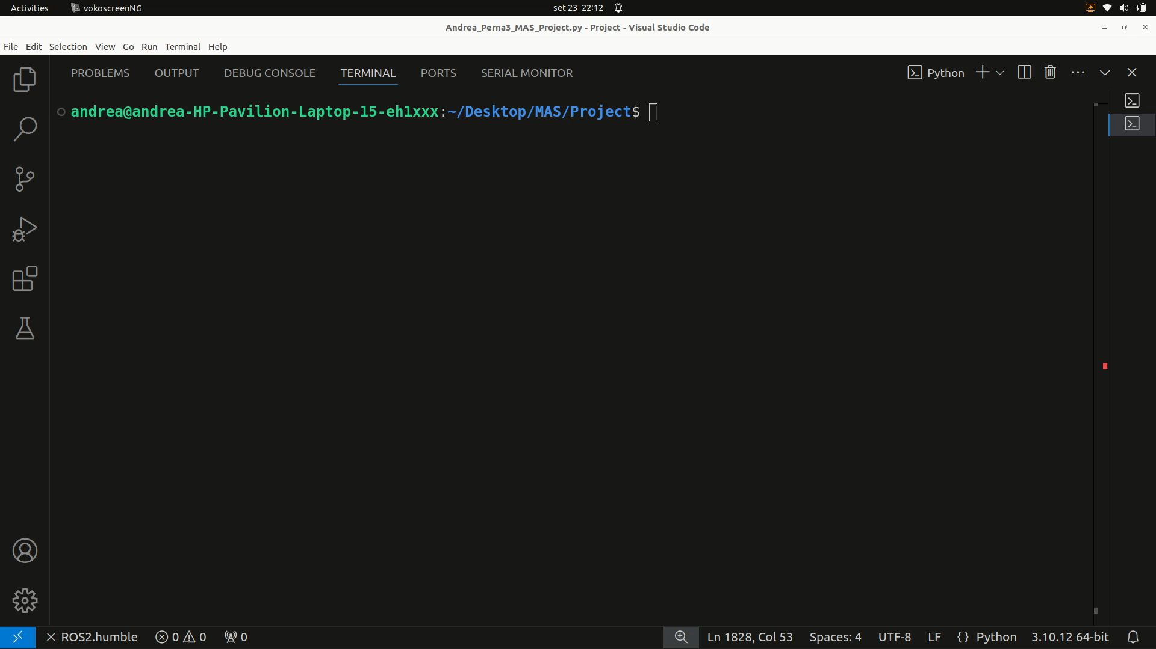
SAR Animation – Computations

Slide 21
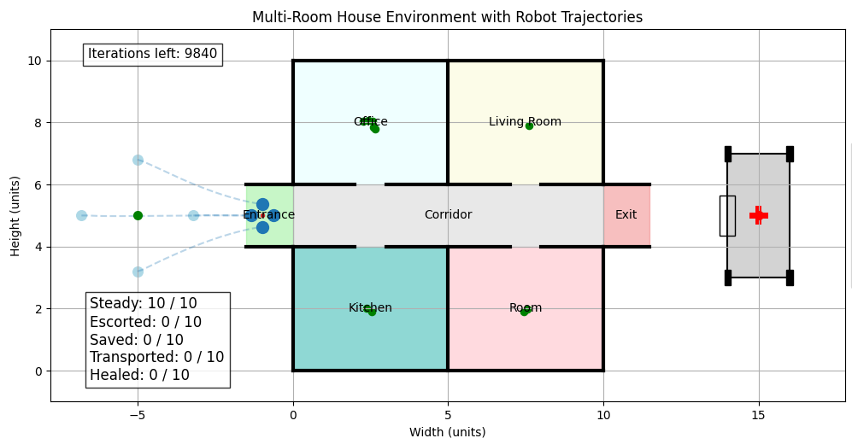
SAR Animation – Static View

Slide 22
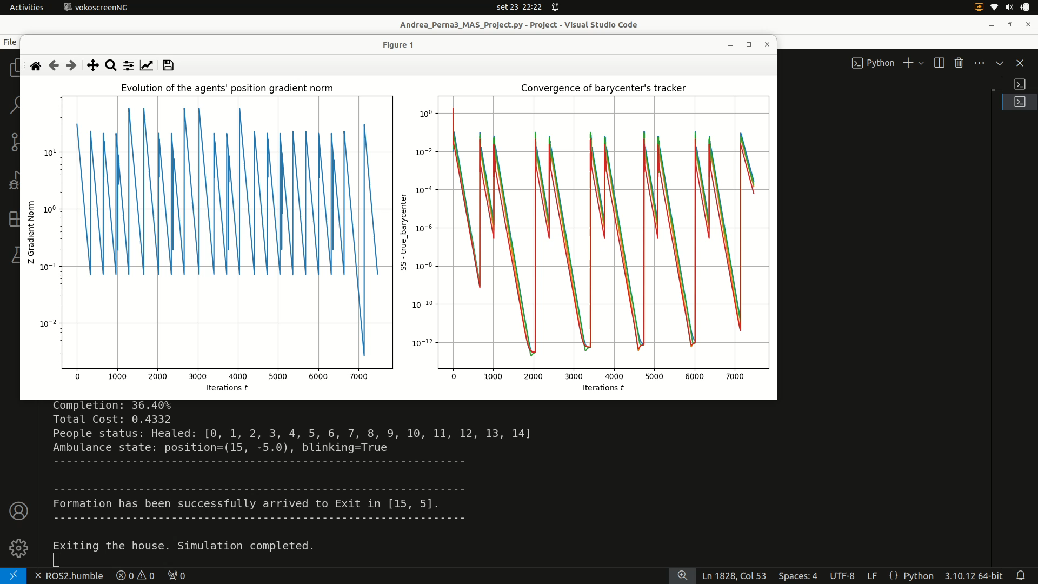
SAR Animation – Static View

Slide 23
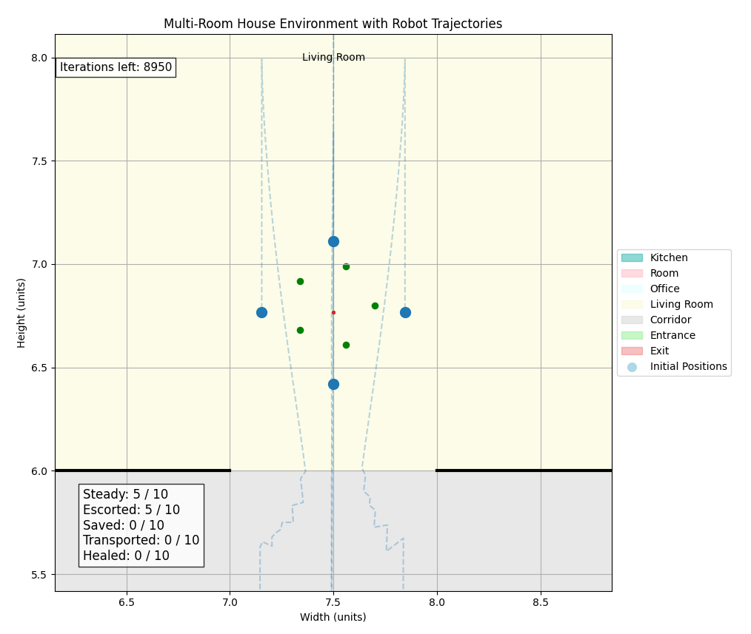
SAR Animation – Dynamic View

Slide 24

SAR Animation – Dynamic View

Slide 25
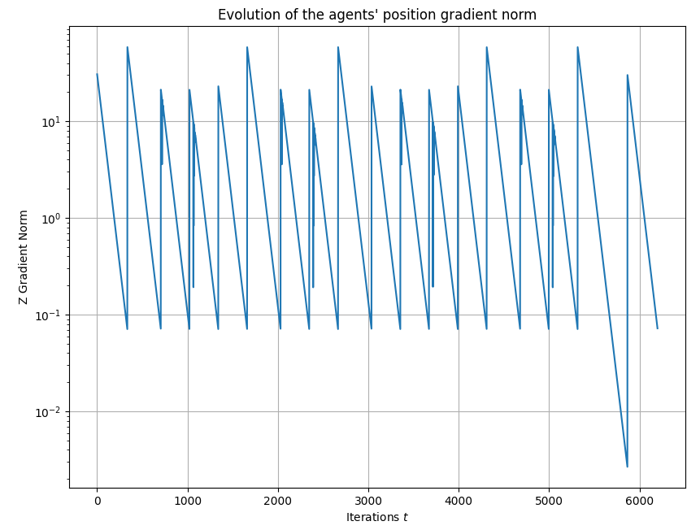
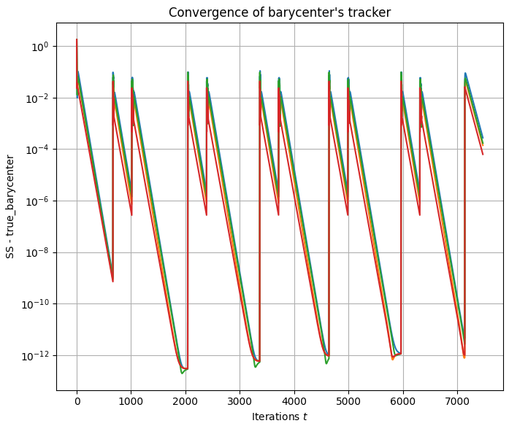
Costs and Gradients

Slide 26

Summary
To summarize, the main characteristics of the developed Multi-Agent System project are:
Modularity and Extensibility;
Distributed Aggregative Optimization;
BDI Mentalistic Agents;
Obstacle Avoidance via Potential Functions;
Real-time Consensus Coordination;
Visualization of SAR Simulations;

Slide 27

Future Enhancements
Implementation in ROS2 distributed framework;
Simultaneous Localization and Mapping (SLAM)
Multi-Agent Reinforcement Learning (MARL);
Battery management and energy constraints;
Computer Vision features to enhance robots’ perception;
Decentralized task allocation to handle resources;
Keep track of health statuses of survivors;

Slide 28

Thanks for your attention!
Keep The Gradient
- Bruno Siciliano -

